Slide 1

Rheumatoid Arthritis Detection
-using ML and Image processing
Project by: 21249-CCN-008,CHALLA DIVYA SRI. 21249-CCN-038,MUVVA BALAJI PRAMOD. 21249-CCN-058,TELLEMEKALA LOKESH. 21249-CCN-066,YELURI RAMADEVI. 21249-CCN-046,PENUMALLU ARJUN REDDY. 21249-CCN-016,EATHAKOTI DENNIS SUJITH SAGAR.
Guide:
Malakala Mani Ratnam.

Slide 2

Contents:
Abstract
Introduction
Existing System
Disadvantages of Existing System
Proposed System
Advantages in Proposed System
System Architecture
Functional Requirements
Conclusion

Slide 3
Abstract
This study proposes a novel approach for the early detection of rheumatoid arthritis (RA) utilizing image processing techniques. By analyzing medical imaging data, such as X-rays or ultrasound images, our method aims to identify characteristic features and patterns associated with RA. Leveraging advanced image processing algorithms, we can extract relevant information and generate automated diagnostic tools for efficient and accurate detection of RA. This research presents a promising avenue for improving early diagnosis and treatment of RA, ultimately enhancing patient outcomes and quality of life.

Slide 4

Introduction:
Rhemautoid arthritis(RH) is a chronic autoimmune disease that affects the joints of the body.Early detection of RA is crucial for timely treatment and management of the disease.
Currently, manual examination by a rheumatologist is the primary method for RA detection.

Slide 5
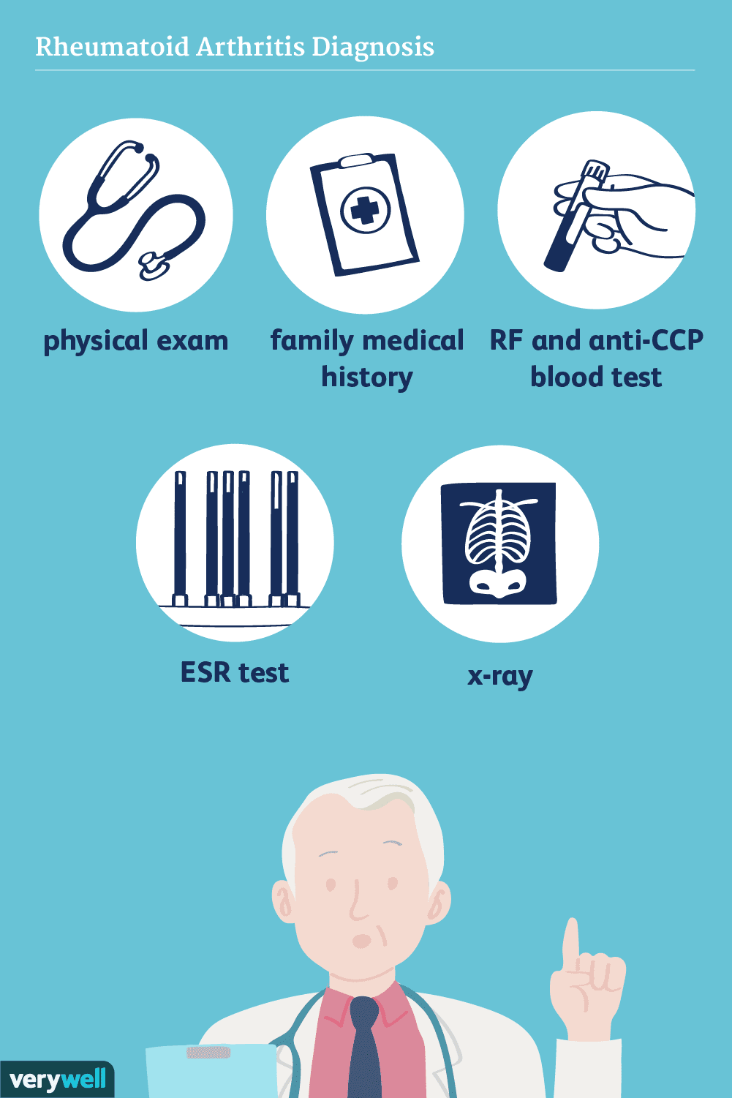

Existing System:
There are currently several existing systems for Rheumatoid Arthritis(RA) detection using image processing techniques.
Some of the notable ones
include:
Clinical Examination
Blood Tests
Imaging Techniques

Slide 6

Disadvantages of Existing System:
Inaccuracy:
Manual testing may be prone to errors and inaccuracies due to human error.
Time-consuming:
Manual testing methods can be time-consuming and may delay the diagnosis and treatment of RA.
Cost:
Manual testing may require more resources, such as specialized equipment, trained personnel.

Slide 7
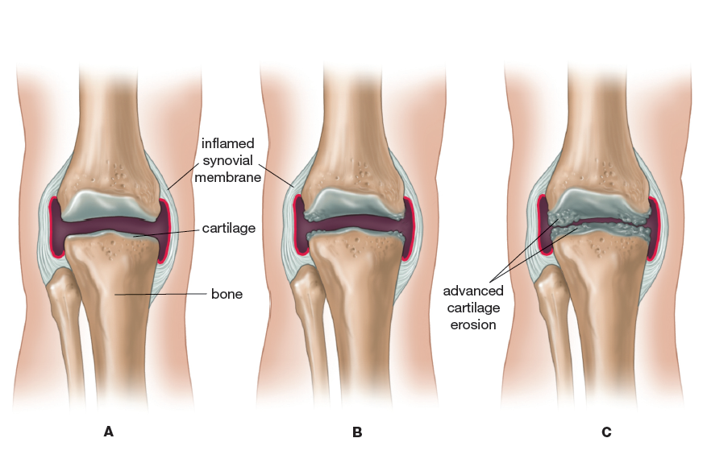
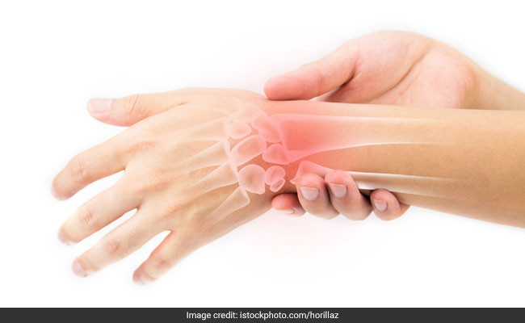
Proposed System
To address these limitations, a proposed system using image processing has been developed.
This system aims to provide a faster, more objective, and accurate method for detecting rheumatoid arthritis.
Proposed system uses image processing techniques to analyze digital images of the hands and joints of patients.

Slide 8
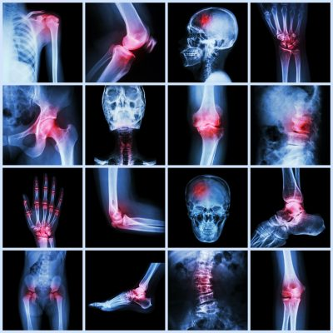
The system first captures high-resolution images of the hands and joints using a digital camera .
These images are then processed using various image processing algorithms, including edge detection, segmentation, and feature extraction.
Then classify the images into either normal or abnormal and detects the Rheumatoid Arthritis.

Slide 9
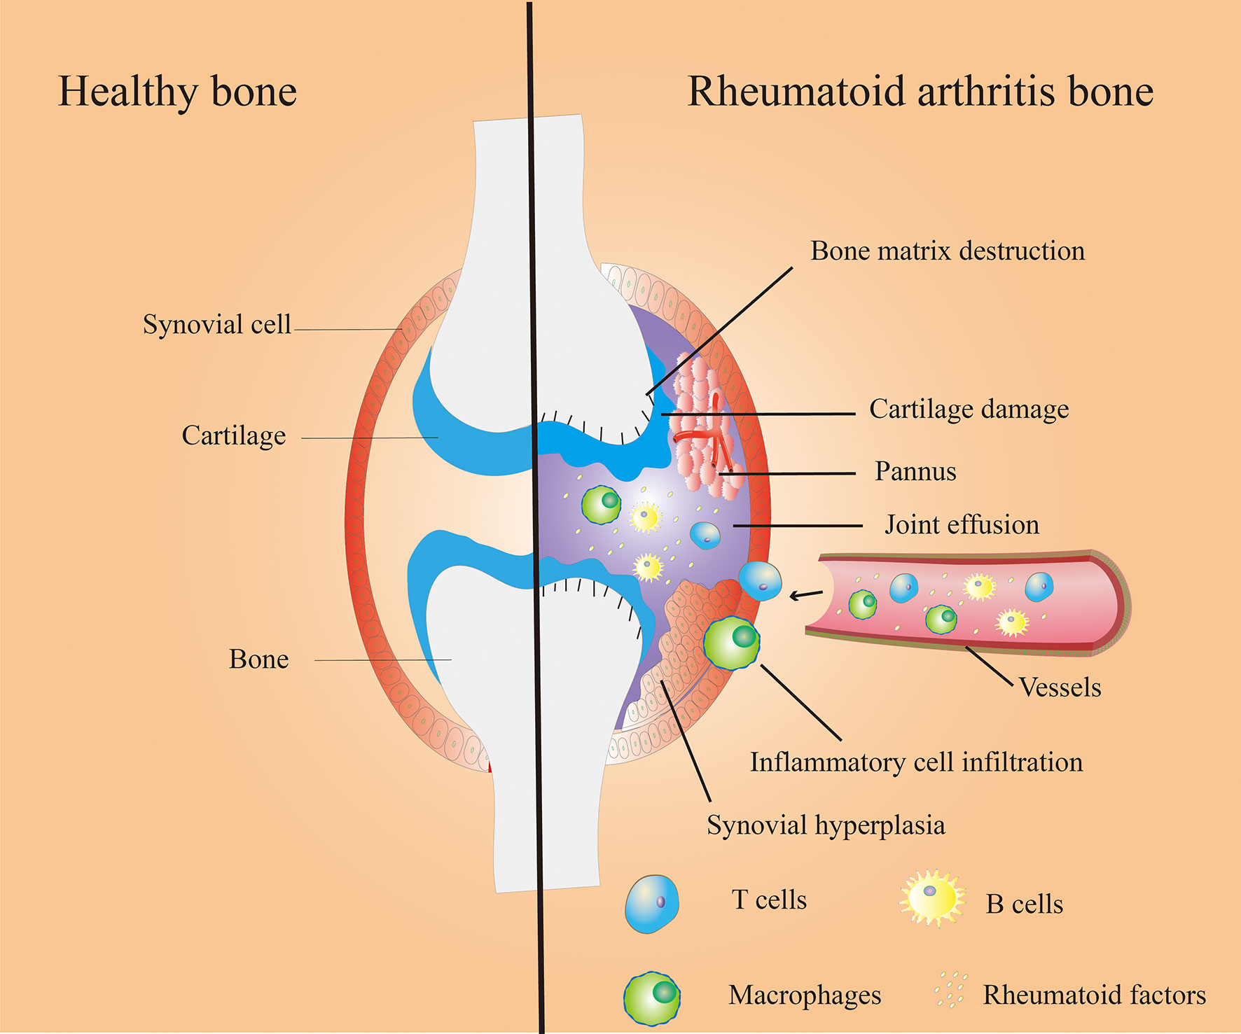
Advantages in Proposed System:
Here are some potential advantages of Rheumatoid Arthritis detection using processing:
Improved Accuracy
Early Detection
Efficiency
Standardization

Slide 10
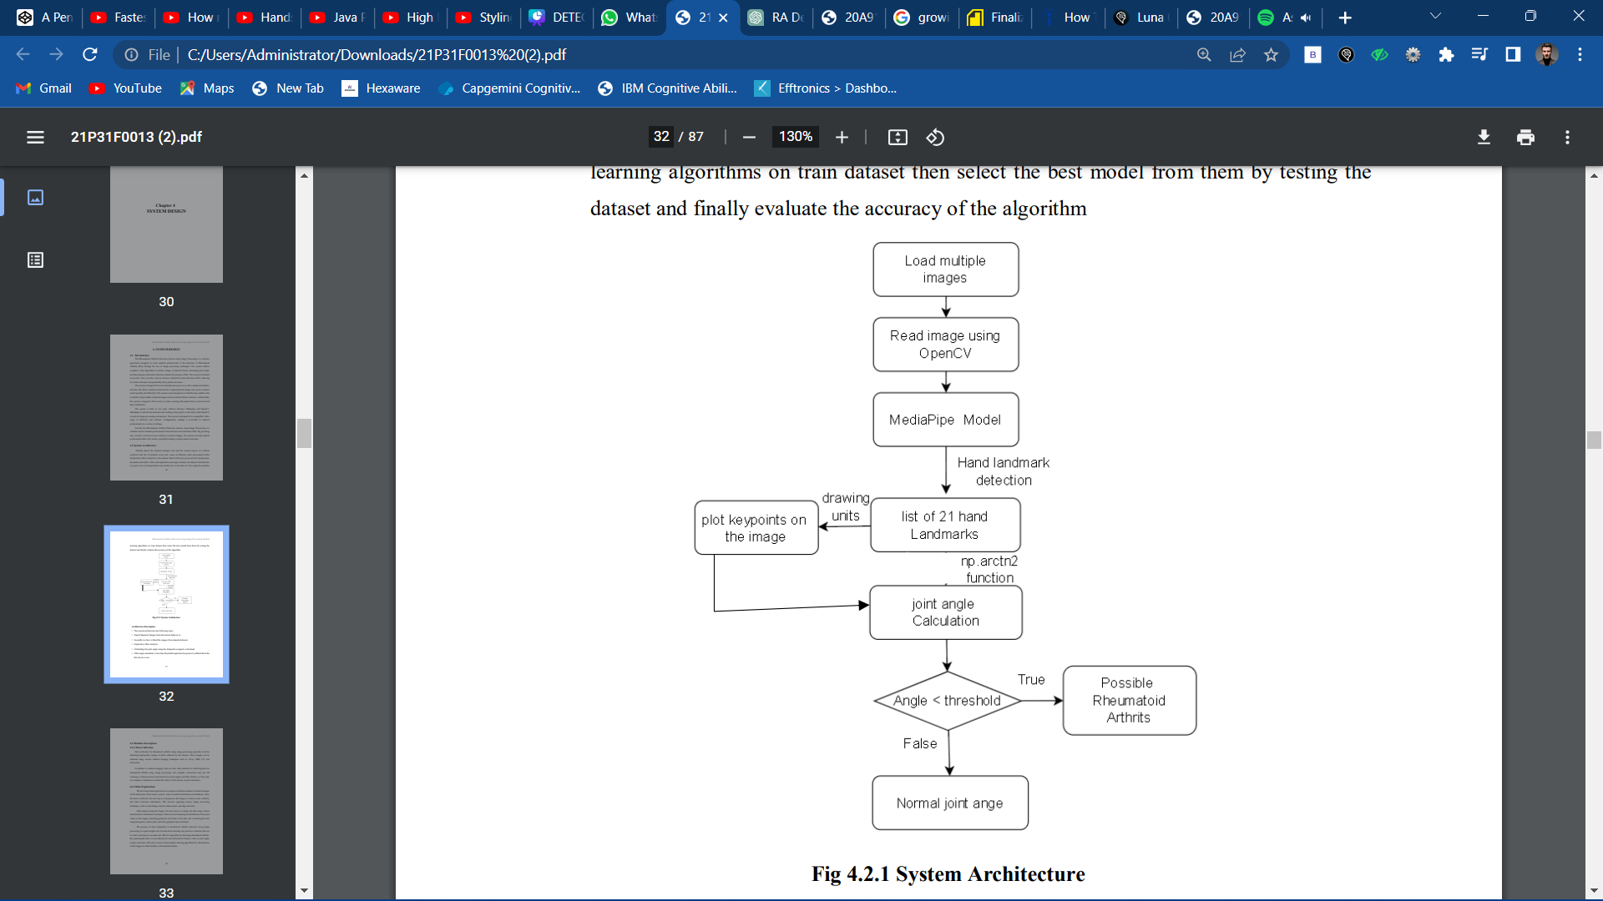
System Architecture

Slide 11
The system architecture has following steps:
Import Required Images from the dataset helps us to
Secondly we have to Read the images from imported dataset
Exploratory Data Analysis .
Calculating the joint angle using the datapoints assigned on the hand .
If the angle calculated is less than threshold angle then the person is suffered form the RA else he is not.

Slide 12


Functional Requirements
Image acquisition
Image preprocessing
Joint detection
Joint segmentation
Feature extraction
RA detection
User interface
Performance evaluation
Feature extraction
RA detection
User interface
Performance evaluation

Slide 13
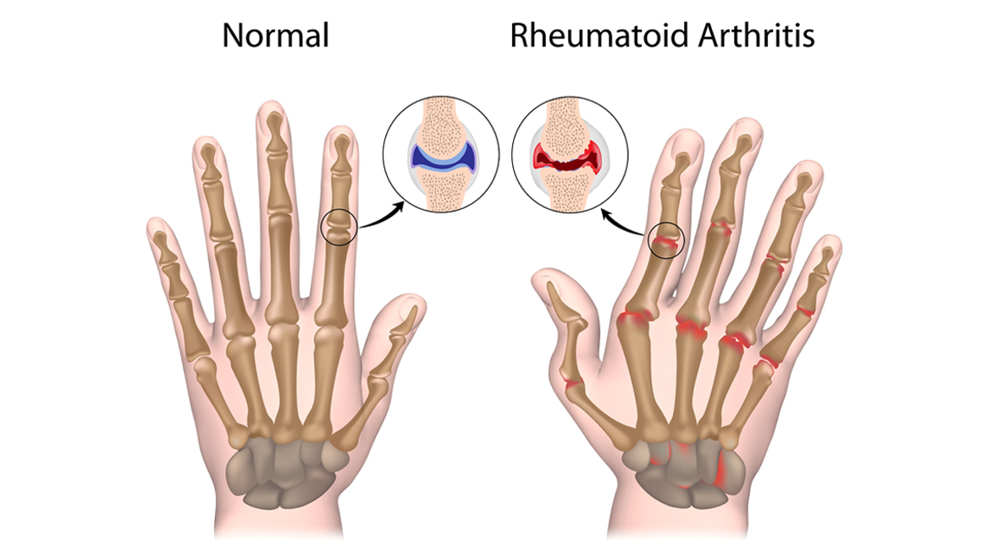
Conclusion:
In conclusion,By utilizing image processing, joint detection, segmentation, and feature extraction, accurate and efficient RA detection can be achieved,with the help of algorithms, user-friendly interfaces, and performance evaluation, this approach offers improved early diagnosis and treatment, ultimately enhancing patient outcomes.

Slide 14


